Slide 1
Can anyone guess when the Current School Uniform was brought in?
1999
Not even in the 21st Century
Here are some 90’s fashion trends…

Slide 2
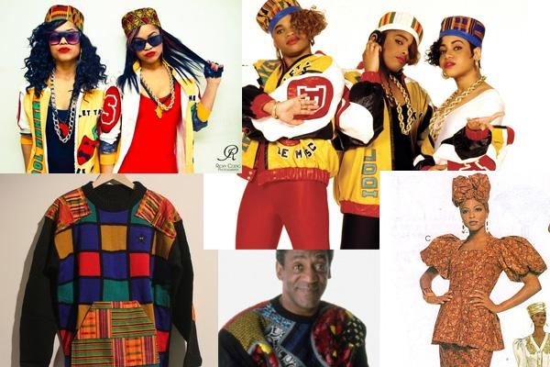

Slide 3
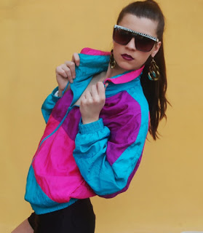

Slide 4
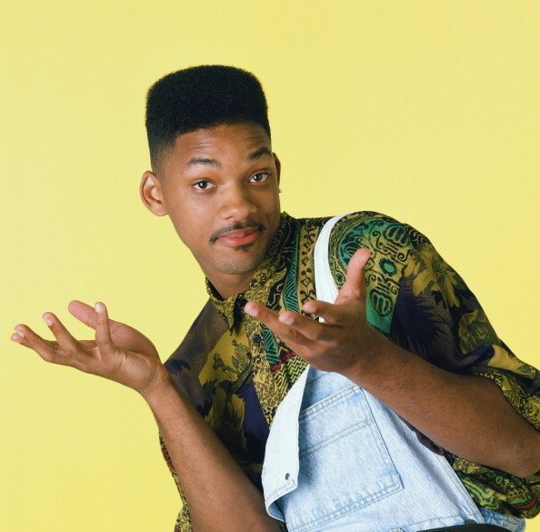

Slide 5
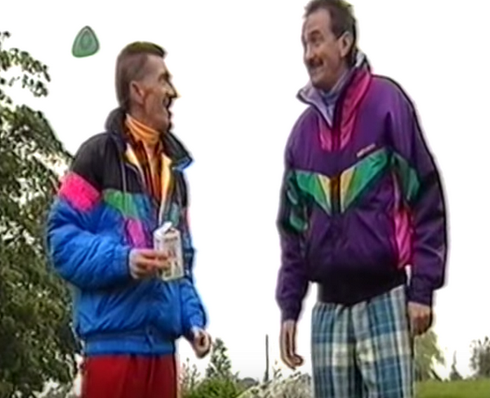

Slide 6
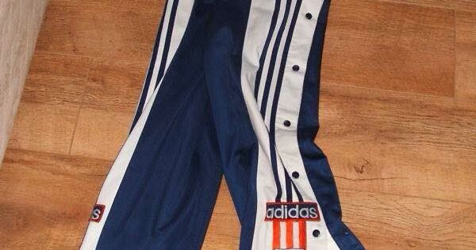

Slide 7
Here are some of the comments about the current School Uniform
Old Fashioned
Drab
Childish
Scruffy
Boring
Not fashionable
People don’t stick to it
We feel like other schools look better than us at events

Slide 8
Change is needed!
We want the change to be led by pupils.
Particularly senior pupils.
What we are looking for:
Makes us look good
Makes us look united
We want it to embody our core values
We want to look worthy of the new school
A Uniform for the 21st Century
The only thing not on the table is dress down
Other than that we are willing to allow you to steer it in any direction you like…

Slide 10
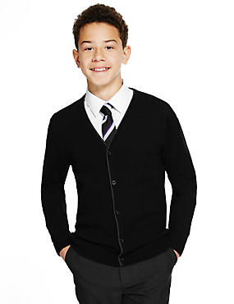

Slide 11
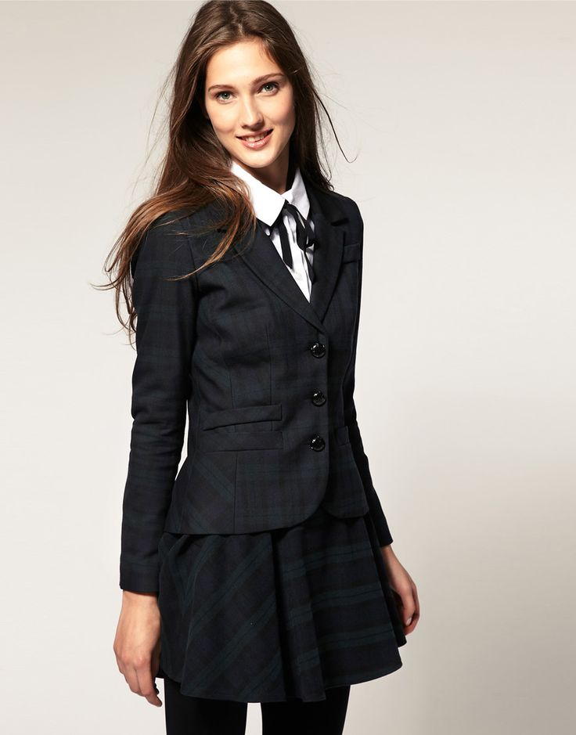

Slide 12
Although there are some things we would still have to veto if things got out of hand

Slide 13
Starter Proposal
To offer Senior pupils the option of Shirt and tie after summer 2017
Inverurie Academy will supply pupils with a free tie to facilitate this
Inverurie Academy will make a selection of knitwear available for autumn/winter 2017
Note: The uniform we implement may differ from the shirts and ties.
This would represent the first step in a new uniform policy for Inverurie Academy

Slide 14
Process
S6 pupils (current S5) will be consulted regarding this proposal
Uniform update will be taking place during 2017/18 session
We are offering the S6 the option to lead the way
Voting will be conducted by way of a yes no exit poll from assembly hall. This will happen by secret Ballot.
Once we know the outcome of the S6 poll S4 (current S3) and S5 (current S4) will be consulted in the same manner on whether they wish to be part of the proposal
Going forward Mr Paterson will organise consultation groups beginning after summer

Slide 15
Progression
If the vote is a yes year groups taking part will be issued with a free tie
At the start of the summer term 2017/18 shirt and tie will become mandatory for participating year groups
CP will source Jumpers and Cardigans and will consult with participating year groups

Slide 16
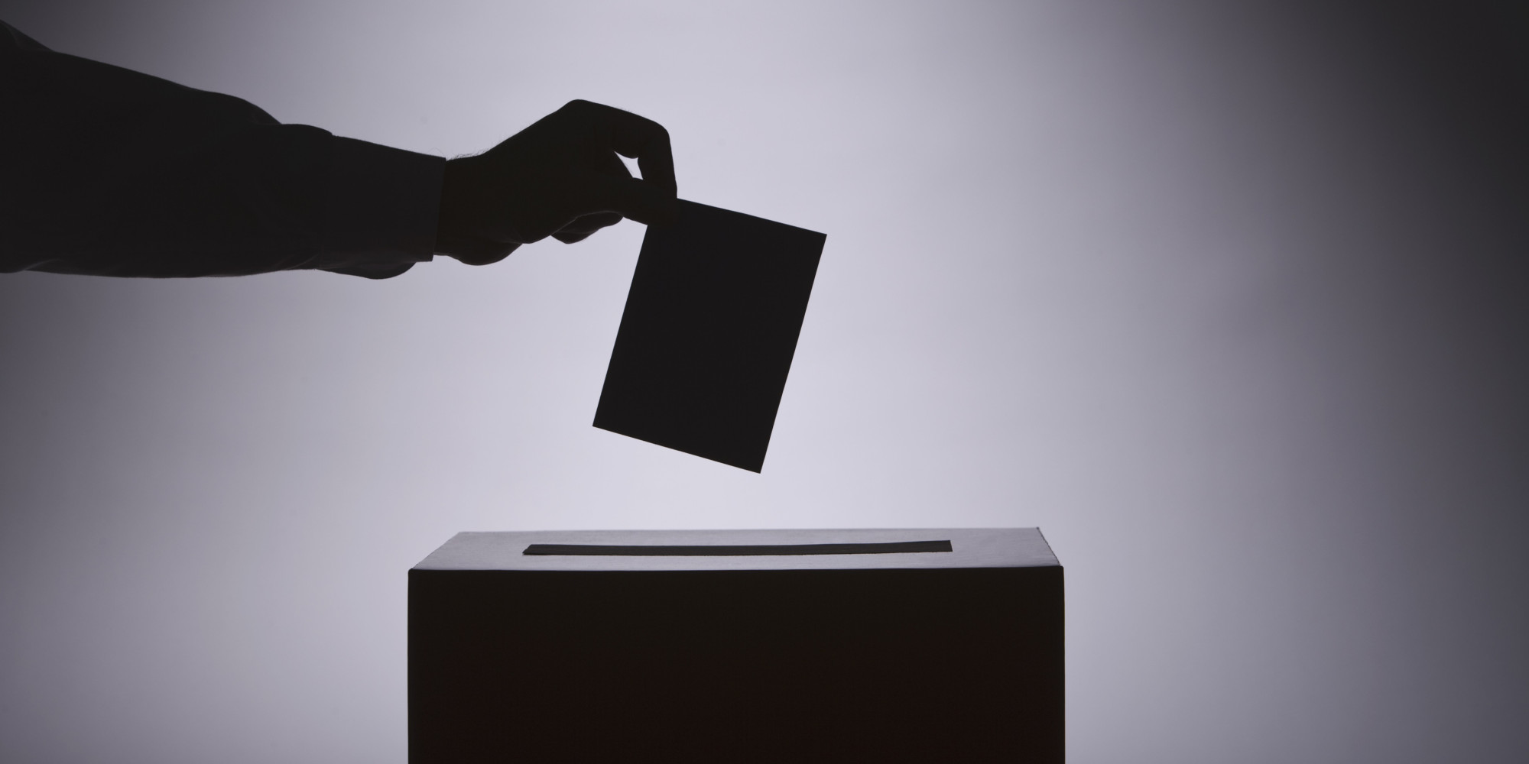

Slide 17
Outcome S6
94 pupils voted
Yes = 81 (86%)
No = 13 (14%)
Therefore the result of the consultation is an overwhelming yes and S6 at Inverurie academy will be in shirts and ties after summer.

Slide 18
Outcome S5
101 pupils polled
No = 39 (39%)
Yes = 62 (61%)
Therefore the result of the consultation is an overwhelming yes and S6 at Inverurie academy will be in shirts and ties after summer.

Slide 19
Outcome S4
142 pupils polled
No = 73 (51%)
Yes = 69 (49%)
Therefore the result of the consultation is a narrow no.
Current school uniform will continue for next year

